Slide 1
Programming With C++/R
DST102TC
Huakang Li
Huakang.li@xjtlu.edu.cn
School of AI and Advanced Computing
Notes:
English Title: Uppercase, Calibri size 60, XJTLU Navy
English Subtitle: Uppercase, Calibri size 36, XJTLU Navy

Slide 2
Chapter 10
Object-Oriented Thinking
Notes:
English Title: Uppercase, Calibri size 60, XJTLU Navy
English Subtitle: Uppercase, Calibri size 36, XJTLU Navy

Slide 3
Objectives
To process strings using the string class (§10.2).
To develop functions with object arguments (§10.3).
To store and process objects in arrays (§10.4).
To distinguish between instance and static variables and functions (§10.5).
To define constant functions to prevent data fields from being modified accidentally (§10.6).
To explore the differences between the procedural paradigm and object-oriented paradigm (§10.7).
To design a class for body mass index (§10.7).
To develop classes for modeling composition relationships (§10.8).
To design a class for a stack (§10.9).
To design classes that follow the class-design guidelines (§10.10).

Slide 4
Constructing a String
You can create an empty string using string’s no-arg constructor like this one:
string newString;
You can create a string object from a string value or from an array of characters. To create a string from a string literal, use a syntax like this one:
string newString(stringLiteral);

Slide 5
Appending a String

Slide 6
Appending a String Examples
You can use several overloaded functions to add new contents to a string. For example, see the following code:
string s1("Welcome");
s1.append(" to C++"); // appends " to C++" to s1
cout << s1 << endl; // s1 now becomes Welcome to C++
string s2("Welcome");
s2.append(" to C and C++", 0, 5); // appends " to C" to s2
cout << s2 << endl; // s2 now becomes Welcome to C
string s3("Welcome");
s3.append(" to C and C++", 5); // appends " to C" to s3
cout << s3 << endl; // s3 now becomes Welcome to C
string s4("Welcome");
s4.append(4, 'G'); // appends "GGGG" to s4
cout << s4 << endl; // s4 now becomes WelcomeGGGG

Slide 7
Assigning a String

Slide 8
Assigning a String Examples
You can use several overloaded functions to assign new contents to a string. For example, see the following code:
string s1("Welcome");
s1.assign("Dallas"); // assigns "Dallas" to s1
cout << s1 << endl; // s1 now becomes Dallas
string s2("Welcome");
s2.assign("Dallas, Texas", 0, 5); // assigns "Dalla" to s2
cout << s2 << endl; // s2 now becomes Dalla
string s3("Welcome");
s3.assign("Dallas, Texas", 5); // assigns "Dalla" to s3
cout << s3 << endl; // s3 now becomes Dalla
string s4("Welcome");
s4.assign(4, 'G'); // assigns "GGGG" to s4
cout << s4 << endl; // s4 now becomes GGGG

Slide 9
Functions at, clear, erase, and empty
C++11: front() and back() are defined in C++11

Slide 10
Functions at, clear, erase, and empty Examples
You can use the at(index) function to retrieve a character at a specified index, clear() to clear the string, erase(index, n) to delete part of the string, and empty() to test if a string is empty. For example, see the following code:
string s1("Welcome");
cout << s1.at(3) << endl; // s1.at(3) returns c
cout << s1.erase(2, 3) << endl; // s1 is now Weme
s1.clear(); // s1 is now empty
cout << s1.empty() << endl; // s1.empty returns 1 (means true)

Slide 11
Functions length, size, capacity, and c_str()

Slide 12
Functions length, size, capacity, and c_str() Examples
string s1("Welcome");
cout << s1.length() << endl; // Length is 7
cout << s1.size() << endl; // Size is 7
cout << s1.capacity() << endl; // Capacity is 7
s1.erase(1, 2);
cout << s1.length() << endl; // Length is now 5
cout << s1.size() << endl; // Size is now 5
cout << s1.capacity() << endl; // Capacity is still 7

Slide 13
Comparing Strings
Often, in a program, you need to compare the contents of two strings.
You can use the compare function. This function works in the same way as the C-string strcmp function and returns a value greater than 0, 0, or less than 0. For example, see the following code:
string s1("Welcome");
string s2("Welcomg");
cout << s1.compare(s2) << endl; // returns -2
cout << s2.compare(s1) << endl; // returns 2
cout << s1.compare("Welcome") << endl; // returns 0

Slide 14
Obtaining Substrings
You can obtain a single character from a string using the at function.
You can also obtain a substring from a string using the substr function. For example, see the following code:
string s1("Welcome");
cout << s1.substr(0, 1) << endl; // returns W
cout << s1.substr(3) << endl; // returns come
cout << s1.substr(3, 3) << endl; // returns com

Slide 15
Searching in a String
You can use the find function to search for a substring or a character in a string.
For example, see the following code:
string s1("Welcome to HTML");
cout << s1.find("co") << endl; // returns 3
cout << s1.find("co", 6) << endl; // returns -1
cout << s1.find('o') << endl; // returns 4
cout << s1.find('o', 6) << endl; // returns 9

Slide 16
Inserting and Replacing Strings
Here are the examples to use the insert and replace functions:
string s1("Welcome to HTML");
s1.insert(11, "C++ and ");
cout << s1 << endl; // s1 becomes Welcome to C++ and HTML
string s2("AA");
s2.insert(1, 4, 'B');
cout << s2 << endl; // s2 becomes to ABBBBA
string s3("Welcome to HTML");
s3.replace(11, 4, "C++");
cout << s3 << endl; // returns Welcome to C++

Slide 17
String Operators

Slide 18
Converting Numbers to Strings
You can also use the itoa function to convert an integer to a string. Sometimes you need to convert a floating-point number to a string.
You can write a function to perform the conversion. However, a simple approach is to use the stringstream class in the <sstream> header.
1 stringstream ss;
2 ss << 3.1415;
3 string s = ss.str();

Slide 19
Splitting Strings
Often you need to extract the words from a string. Assume that the words are separated by whitespaces.
You can use the stringstream class discussed in the preceding section to accomplish this task.

Slide 20
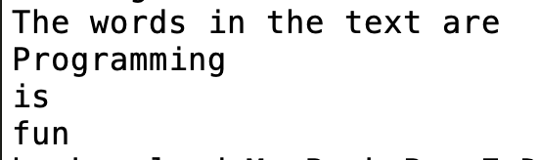
ExtractWords.cpp
#include <iostream>
#include <sstream>
#include <string>
using namespace std;
int main()
{
string text("Programming is fun");
stringstream ss(text);
cout << "The words in the text are " << endl;
string word;
while (!ss.eof())
{
ss >> word;
cout << word << endl;
}
return 0;
}

Slide 21
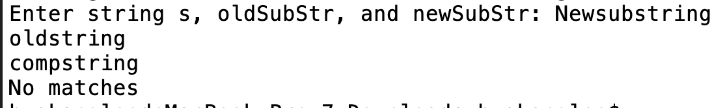
ReplaceString.cpp
bool replaceString(string& s, const string& oldSubStr,
const string& newSubStr)
{
bool isReplaced = false;
int currentPosition = 0;
while (currentPosition < s.length())
{
int position = s.find(oldSubStr, currentPosition);
if (position == string::npos) // Mo more matches
return isReplaced;
else
{
s.replace(position, oldSubStr.length(), newSubStr);
currentPosition = position + newSubStr.length();
isReplaced = true; // At least one match
}
}
return isReplaced;
}
#include <iostream>
#include <string>
using namespace std;
// Replace oldSubStr in s with newSubStr
bool replaceString(string& s, const string& oldSubStr,
const string& newSubStr);
int main()
{
// Prompt the user to enter s, oldSubStr, and newSubStr
cout << "Enter string s, oldSubStr, and newSubStr: ";
string s, oldSubStr, newSubStr;
cin >> s >> oldSubStr >> newSubStr;
bool isReplaced = replaceString(s, oldSubStr, newSubStr);
if (isReplaced)
cout << "The replaced string is " << s << endl;
else
cout << "No matches" << endl;
return 0;
}

Slide 22
Reading Strings
string city;
cout << "Enter a city: ";
cin >> city; // Read to array city
cout << "You entered " << city << endl;
string city;
cout << "Enter a city: ";
getline(cin, city, '\n'); // Same as getline(cin, city)
cout << "You entered " << city << endl;

Slide 23
Passing Objects to Functions
You can pass objects by value or by reference.

Slide 24
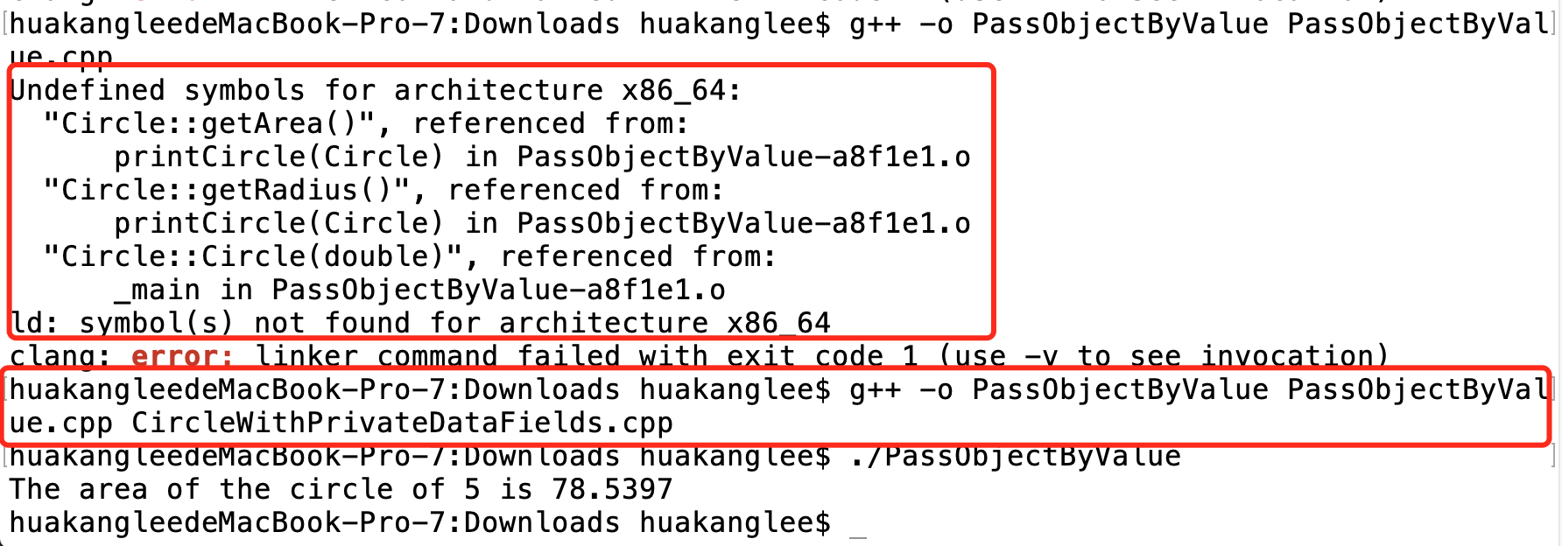
PassObjectByValue.cpp
#include <iostream>
// CircleWithPrivateDataFields.h is defined in Listing 9.9
#include "CircleWithPrivateDataFields.h"
using namespace std;
void printCircle(Circle c)
{
cout << "The area of the circle of "
<< c.getRadius() << " is " << c.getArea() << endl;
}
int main()
{
Circle myCircle(5.0);
printCircle(myCircle);
return 0;
}

Slide 25
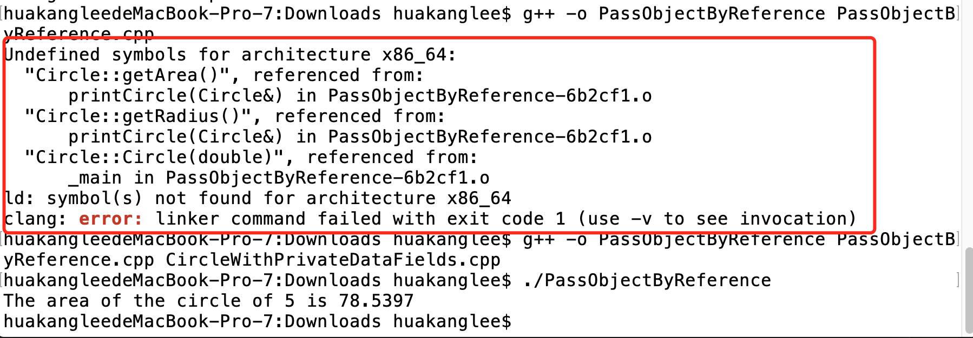
PassObjectByReference.cpp
#include <iostream>
#include "CircleWithPrivateDataFields.h"
using namespace std;
void printCircle(Circle& c)
{
cout << "The area of the circle of "
<< c.getRadius() << " is " << c.getArea() << endl;
}
int main()
{
Circle myCircle(5.0);
printCircle(myCircle);
return 0;
}

Slide 26
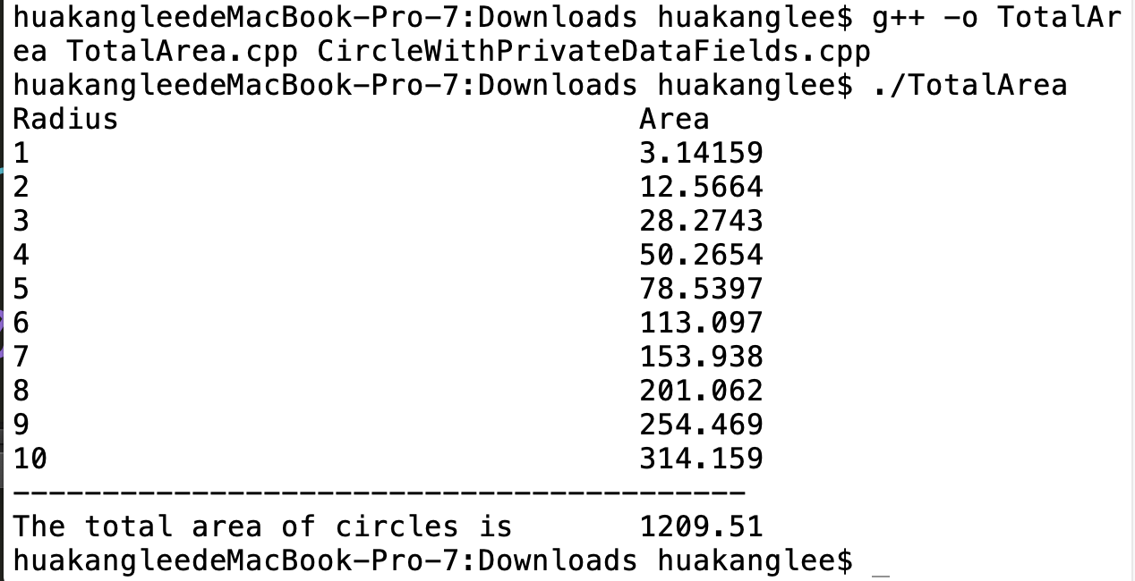
TotalArea.cpp
int main()
{
const int SIZE = 10;
// Create a Circle object with radius 1
Circle circleArray[SIZE];
for (int i = 0; i < SIZE; i++)
{
circleArray[i].setRadius(i + 1);
}
printCircleArray(circleArray, SIZE);
return 0;
}
#include <iostream>
#include <iomanip>
#include "CircleWithPrivateDataFields.h"
using namespace std;
// Add circle areas
double sum(Circle circleArray[], int size){
// Initialize sum
double sum = 0;
// Add areas to sum
for (int i = 0; i < size; i++)
sum += circleArray[i].getArea();
return sum;
}
// Print an array of circles and their total area
void printCircleArray(Circle circleArray[], int size){
cout << setw(35) << left << "Radius" << setw(8) << "Area" << endl;
for (int i = 0; i < size; i++)
{
cout << setw(35) << left << circleArray[i].getRadius()
<< setw(8) << circleArray[i].getArea() << endl;
}
cout << "-----------------------------------------" << endl;
// Compute and display the result
cout << setw(35) << left << "The total area of circles is"
<< setw(8) << sum(circleArray, size) << endl;
}

Slide 27
Instance and Static Members

Slide 28
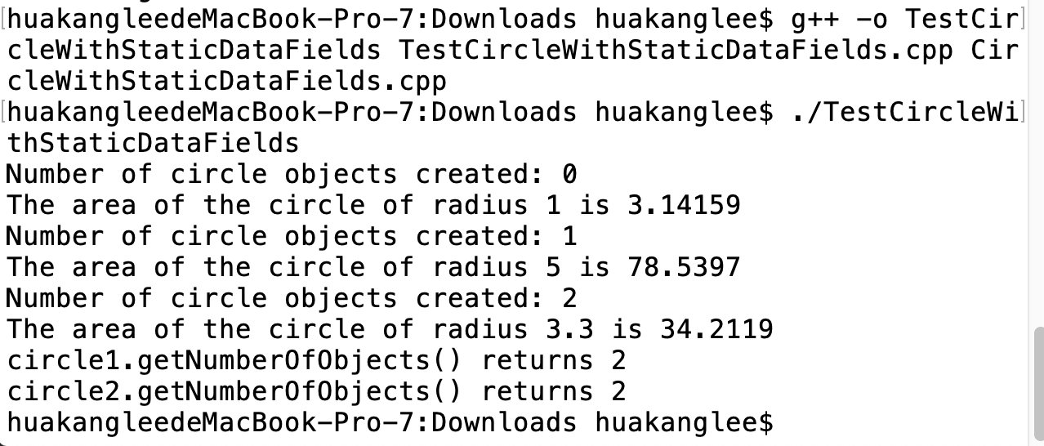
TestCircleWithStaticDataFields.cpp
#include <iostream>
#include "CircleWithStaticDataFields.h"
using namespace std;
int main(){
cout << "Number of circle objects created: "
<< Circle::getNumberOfObjects() << endl;
Circle circle1;
cout << "The area of the circle of radius "
<< circle1.getRadius() << " is " << circle1.getArea() << endl;
cout << "Number of circle objects created: "
<< Circle::getNumberOfObjects() << endl;
Circle circle2(5.0);
cout << "The area of the circle of radius "
<< circle2.getRadius() << " is " << circle2.getArea() << endl;
cout << "Number of circle objects created: "
<< Circle::getNumberOfObjects() << endl;
circle1.setRadius(3.3);
cout << "The area of the circle of radius "
<< circle1.getRadius() << " is " << circle1.getArea() << endl;
cout << "circle1.getNumberOfObjects() returns "
<< circle1.getNumberOfObjects() << endl;
cout << "circle2.getNumberOfObjects() returns "
<< circle2.getNumberOfObjects() << endl;
return 0;
}

Slide 29
CircleWithStaticDataFields.h
CircleWithStaticDataFields.cpp
#include "CircleWithStaticDataFields.h"
int Circle::numberOfObjects = 0;
// Construct a circle object
Circle::Circle(){
radius = 1;
numberOfObjects++;
}
// Construct a circle object
Circle::Circle(double newRadius){
radius = newRadius;
numberOfObjects++;
}
// Return the area of this circle
double Circle::getArea(){
return radius * radius * 3.14159;
}
// Return the radius of this circle
double Circle::getRadius(){
return radius;
}
// Set a new radius
void Circle::setRadius(double newRadius){
radius = (newRadius >= 0) ? newRadius : 0;
}
// Return the number of circle objects
int Circle::getNumberOfObjects(){
return numberOfObjects;
}
#ifndef CIRCLE_H
#define CIRCLE_H
class Circle
{
public:
Circle();
Circle(double);
double getArea();
double getRadius();
void setRadius(double);
static int getNumberOfObjects();
private:
double radius;
static int numberOfObjects;
};
#endif

Slide 30
Use Class Name
Use ClassName::functionName(arguments) to invoke a static function and ClassName::staticVariable. This improves readability because the user can easily recognize the static function and data in the class.

Slide 31
Instance or Static?
How do you decide whether a variable or function should be instance or static?
A variable or function that is dependent on a specific instance of the class should be an instance variable or function.
A variable or function that is not dependent on a specific instance of the class should be a static variable or function.
For example, every circle has its own radius. Radius is dependent on a specific circle.
Therefore, radius is an instance variable of the Circle class. Since the getArea function is dependent on a specific circle, it is an instance function.
Since numberOfObjects is not dependent on any specific instance, it should be declared static.

Slide 32
Constant Member Functions
You can use the const keyword to specify a constant parameter to tell the compiler that the parameter should not be changed in the function.
C++ also enables you to specify a constant member function to tell the compiler that the function should not change the value of any data fields in the object.
To do so, place the const keyword at the end of the function header.

Slide 33
CircleWithConstantMemberFunctions.h
CircleWithConstantMemberFunctions.cpp
#include "CircleWithConstantMemberFunctions.h"
int Circle::numberOfObjects = 0;
// Construct a circle object
Circle::Circle(){
radius = 1;
numberOfObjects++;
}
// Construct a circle object
Circle::Circle(double newRadius){
radius = newRadius;
numberOfObjects++;
}
// Return the area of this circle
double Circle::getArea() const{
return radius * radius * 3.14159;
}
// Return the radius of this circle
double Circle::getRadius() const{
return radius;
}
// Set a new radius
void Circle::setRadius(double newRadius){
radius = (newRadius >= 0) ? newRadius : 0;
}
// Return the number of circle objects
int Circle::getNumberOfObjects(){
return numberOfObjects;
}
#ifndef CIRCLE_H
#define CIRCLE_H
class Circle
{
public:
Circle();
Circle(double);
double getArea() const;
double getRadius() const;
void setRadius(double);
static int getNumberOfObjects();
private:
double radius;
static int numberOfObjects;
};
#endif

Slide 34
Object-Oriented Thinking
The book introduced fundamental programming techniques for problem solving using loops, functions, and arrays.
The study of these techniques lays a solid foundation for object-oriented programming.
Classes provide more flexibility and modularity for building reusable software.
This section improves the solution for a problem introduced in Chapter 3 using the object-oriented approach.
From the improvements, you will gain insight on the differences between the procedural programming and object-oriented programming and see the benefits of developing reusable code using objects and classes.

Slide 35
The BMI Class

Slide 36
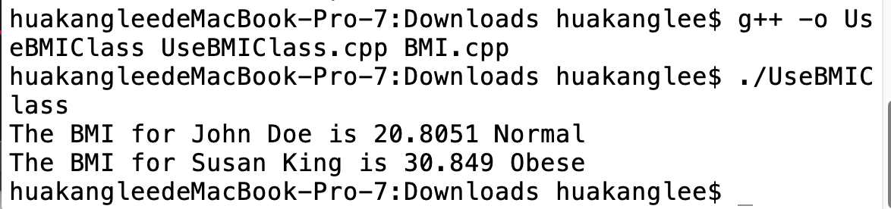
UseBMIClass.cpp
#include <iostream>
#include "BMI.h"
using namespace std;
int main()
{
BMI bmi1("John Doe", 18, 145, 70);
cout << "The BMI for " << bmi1.getName() << " is "
<< bmi1.getBMI() << " " << bmi1.getStatus() << endl;
BMI bmi2("Susan King", 215, 70);
cout << "The BMI for " << bmi2.getName() << " is "
<< bmi2.getBMI() << " " + bmi2.getStatus() << endl;
return 0;
}

Slide 37
BMI.h
BMI.cpp
#include <iostream>
#include "BMI.h"
using namespace std;
BMI::BMI(const string& newName, int newAge,
double newWeight, double newHeight){
name = newName;
age = newAge;
weight = newWeight;
height = newHeight;}
BMI::BMI(const string& newName, double newWeight, double newHeight){
name = newName;
age = 20;
weight = newWeight;
height = newHeight;}
double BMI::getBMI() const{
const double KILOGRAMS_PER_POUND = 0.45359237;
const double METERS_PER_INCH = 0.0254;
double bmi = weight * KILOGRAMS_PER_POUND /
((height * METERS_PER_INCH) * (height * METERS_PER_INCH));
return bmi;
}
string BMI::getStatus() const
{
double bmi = getBMI();
if (bmi < 18.5)
return "Underweight";
else if (bmi < 25)
return "Normal";
else if (bmi < 30)
return "Overweight";
else
return "Obese";
}
string BMI::getName() const
{
return name;
}
int BMI::getAge() const
{
return age;
}
double BMI::getWeight() const
{
return weight;
}
double BMI::getHeight() const
{
return height;
}
#ifndef BMI_H
#define BMI_H
#include <string>
using namespace std;
class BMI
{
public:
BMI(const string& newName, int newAge,
double newWeight, double newHeight);
BMI(const string& newName, double newWeight, double newHeight);
double getBMI() const;
string getStatus() const;
string getName() const;
int getAge() const;
double getWeight() const;
double getHeight() const;
private:
string name;
int age;
double weight;
double height;
};
#endif

Slide 38
Object Composition
Composition is actually a special case of the aggregation relationship. Aggregation models has-a relationships and represents an ownership relationship between two objects. The owner object is called an aggregating object and its class an aggregating class. The subject object is called an aggregated object and its class an aggregated class.

Slide 39
Class Representation
An aggregation relationship is usually represented as a data field in the aggregating class. For example, the relationship in the preceding figure can be represented as follows:

Slide 40
Aggregation or Composition
Since aggregation and composition relationships are represented using classes in the same way, we don’t differentiate them and call both compositions.

Slide 41
The StackOfInteger Class
A stack is a data structure that holds objects in a last-in first-out fashion, as illustrated in the next figure. It has many applications.
For example, the compiler uses a stack to process function invocations.
When a function is invoked, the parameters and local variables of the function are pushed into a stack.
When a function calls another function, the new function’s parameters and local variables are pushed into the stack.
When a function finishes its work and returns to its caller, its associated space is released from the stack.

Slide 42
The Stack Of Integer Class

Slide 43
Example: The Stack Of Integers Class

Slide 44
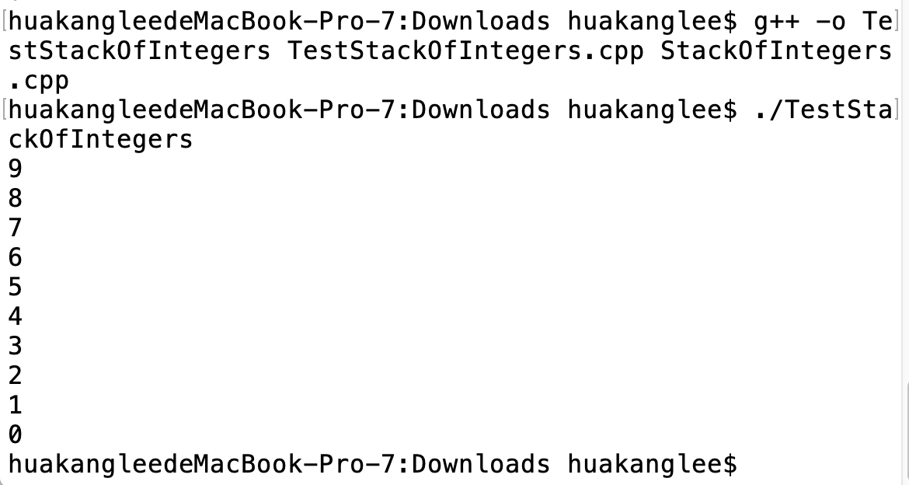
TestStackOfIntegers.cpp
#include <iostream>
#include "StackOfIntegers.h"
using namespace std;
int main()
{
StackOfIntegers stack;
for (int i = 0; i < 10; i++)
stack.push(i);
while (!stack.isEmpty())
cout << stack.pop() << " ";
return 0;
}

Slide 45
StackOfIntegers.h
StackOfIntegers.cpp
#ifndef STACK_H
#define STACK_H
class StackOfIntegers
{
public:
StackOfIntegers();
bool isEmpty() const;
int peek() const;
void push(int value);
int pop();
int getSize() const;
private:
int elements[100];
int size;
};
#endif
#include "StackOfIntegers.h"
StackOfIntegers::StackOfIntegers()
{
size = 0;
}
bool StackOfIntegers::isEmpty() const
{
return size == 0;
}
int StackOfIntegers::peek() const
{
return elements[size - 1];
}
void StackOfIntegers::push(int value)
{
elements[size++] = value;
}
int StackOfIntegers::pop()
{
return elements[--size];
}
int StackOfIntegers::getSize() const
{
return size;
}

Slide 46
Implementation

Slide 47
Designing a Class: Cohesion
A class should describe a single entity or a set of similar operations.
A single entity with too many responsibilities can be broken into several classes to separate responsibilities.

Slide 48
Designing a Class: Consistency
Follow standard programming style and naming conventions.
Choose informative names for classes, data fields, and functions.
A popular style in C++ is to place the data declaration after the functions, and place constructors before functions.

Slide 49
Designing a Class: Encapsulation
A class should use the private modifier to hide its data from direct access by clients. This makes the class easy to maintain.
Provide a get function only if you want the field to be readable, and provide a set function only if you want the field to be updateable.
A class should also hide functions not intended for client use. Such functions should be defined as private.

Slide 50
Designing a Class: Clarity
Users can incorporate classes in many different combinations, orders, and environments.
Therefore, you should design a class that imposes no restrictions on what or when the user can do with it, design the properties in a way that lets the user set them in any order and with any combination of values, and design functions independently of their order of occurrence.
For example, the Loan class contains the functions setLoanAmount, setNumberOfYears, and setAnnualInterestRate. The values of these properties can be set in any order.

Slide 51
Designing a Class: Completeness
Classes are designed for use by many different customers.
In order to be useful in a wide range of applications, a class should provide a variety of ways for customization through properties and functions.
For example, the string class contains more than 20 functions that are useful for a variety of applications.

Slide 52
Designing a Class: Instance vs. Static
A variable or function that is dependent on a specific instance of the class should be an instance variable or function.
A variable that is shared by all the instances of a class should be declared static.
For example, the variable numberOfObjects in Circle in Listing 10.9, is shared by all the objects of the Circle class, and therefore is declared static.
A function that is not dependent on a specific instance should be declared as a static function. For instance, the getNumberOfObjects function in Circle is not tied to any specific instance, and therefore is declared as static functions.

Slide 53
summarization
Assigning String
Function Length
String Operators
String Objects
Constant Function
Stack Class

Slide 54



THANK YOU
Visit us
FOLLOW us
www.xjtlu.edu.cn
Notes:
Title: Uppercase, Calibri size 60, XJTLU Navy

